Slide 1
Electric Circuits and Components
Chapter #1

Slide 2
This chapter reviews the fundamentals of basic electrical components and discrete circuit analysis techniques. These topics are important in understanding and designing all elements in a electronic system, especially discrete circuits for signal conditioning and interfacing
After you read, discuss, study, and apply ideas in this chapter, you will:
Understand differences among resistance, capacitance, and inductance
Be able to define Kirchhoff’s voltage and current laws and apply them to passive circuits that include resistors, capacitors, inductors, voltage sources
Be able to characterize the power dissipated or generated by a circuit
Understand how to reduce noise and interference in electrical circuits
Know how to make reliable voltage and current measurements

Slide 3
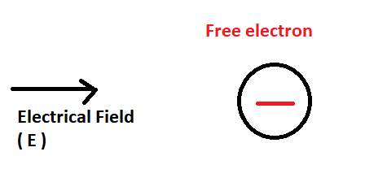
1.1 Introduction
Practically all electonic and measurement systems contain electrical circuits and components. To understand how to design and analyze these systems, a firm grasp of the fundamentals of basic electrical components and circuit analysis techniques is a necessity.
« When electrons move, they produce an electrical current, and we can do useful things with the energized electrons ».
The reason they move is that we impose an electrical field that imparts energy by doing work on the electrons. A measure of the electric field’s potential is called voltage. We can think of voltage as an “across variable” between two points in the field. Voltage is sometimes referred to as electromotive force, or emf. The resulting movement of electrons is the current, a “through variable,” that moves through the field.

Slide 4
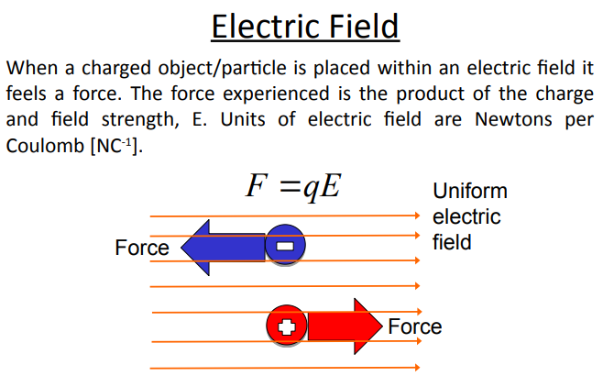

Slide 5
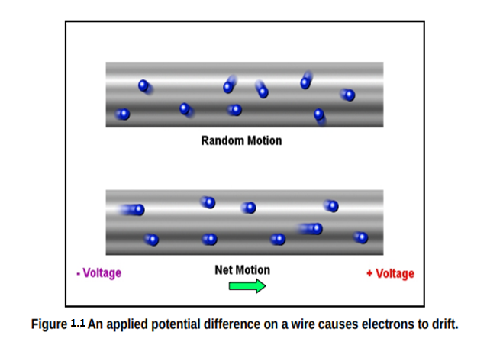
Electrical conduction occurs when we cause all the free electrons to drift in the same direction, like water in a pipe. The electrons are still moving in random directions, but they have a net motion in the direction of the positive charge. The electromotive force (sometimes abbreviated EMF) that causes the electrons to move is called electric potential (denoted by capital E,) and is measured in volts (abbreviated V.) A potential difference applied to a wire from a battery will cause the free electrons to drift in the direction of the positive charge, and away from the negative charge, as shown in Figure 1.1

Slide 6



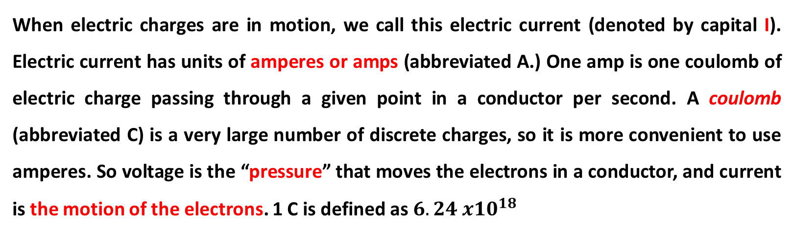
When electric charges are in motion, we call this electric current (denoted by capital I). Electric current has units of amperes or amps (abbreviated A.) One amp is one coulomb of electric charge passing through a given point in a conductor per second. A coulomb (abbreviated C) is a very large number of discrete charges, so it is more convenient to use amperes. So voltage is the “pressure” that moves the electrons in a conductor, and current is the motion of the electrons. 1 C is defined as$6.24 x{10}^{18}$
Current is defined as the time rate of flow of charge
where I denotes current and q denotes quantity of charge.

Slide 7
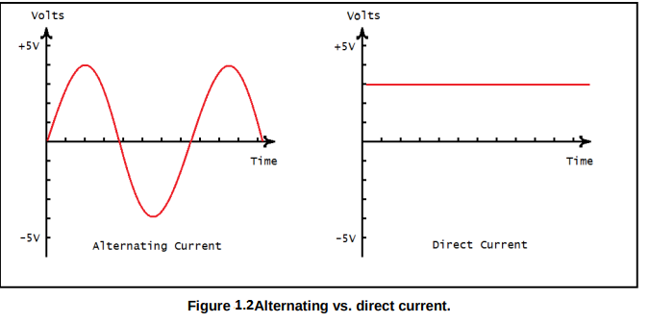
When voltage and current in a circuit are constant (i.e., independent of time), their values and the circuit are referred to as direct current, or DC. When the voltage and current vary with time, usually sinusoidally, we refer to their values and the circuit as alternating current, or AC.
From the figure above, we can see that an AC signal has a voltage that periodically changes from positive to negative, from +4 V to -4 V. The figure above also shows a constant DC voltage of +3 V, on the right. This is usually a sine wave (as in the trigonometric function) but can be any function. Direct current is current that flows in only one direction, and is usually constant. The study of alternating and direct current circuits is called analog circuit theory, and we will be going into this in detail later.

Slide 8
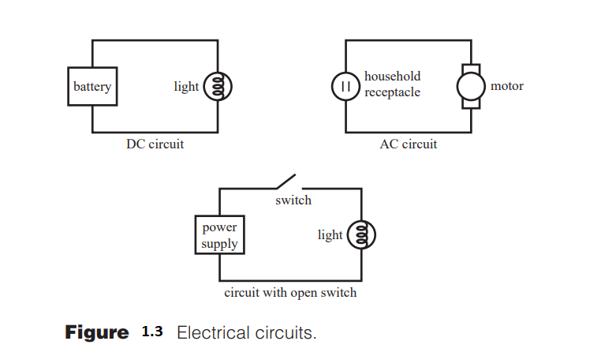
An electrical circuit is a closed loop consisting of several conductors connecting electrical components. Conductors may be interrupted by components called switches. Some simple examples of valid circuits are shown in Figure 1.3

Slide 9
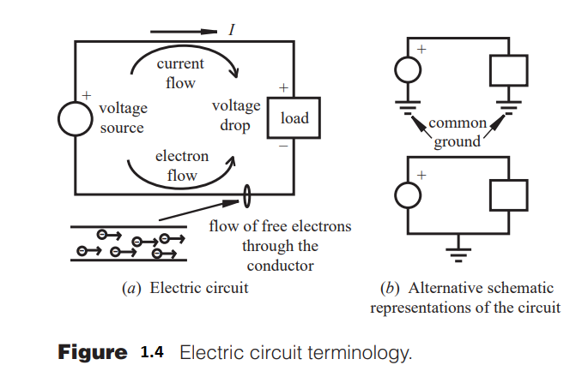
Standard convention assumes that positive charge flows in a direction opposite from the electrons. Current describes the flow of this positive charge (not electrons).
A load consists of a network of circuit elements that may dissipate or store electrical energy
The ground indicates a reference point in the circuit where the voltage is assumed to be zero

Slide 10
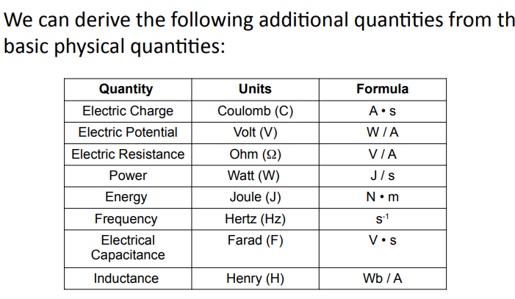

Slide 11
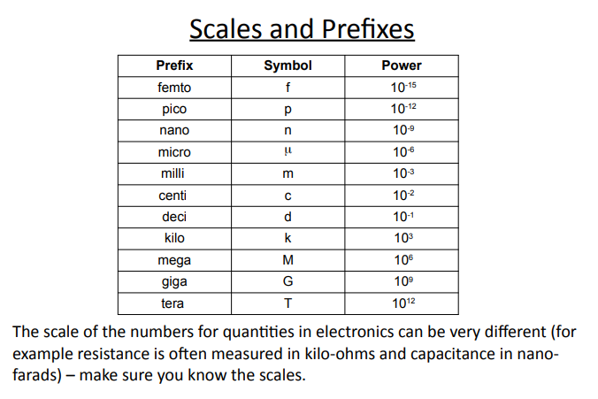

Slide 12
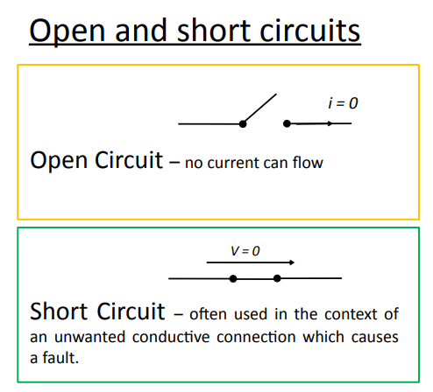

Slide 13
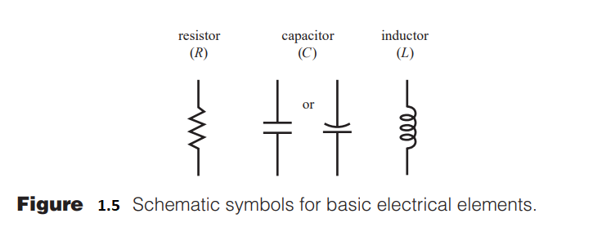
1.2 BASIC ELECTRICAL ELEMENTS
There are three basic passive electrical elements:
the resistor ( R ) ,
capacitor ( C ), and
inductor ( L ).
Passive elements require no additional power supply, unlike active devices such as integrated circuits.

Slide 14
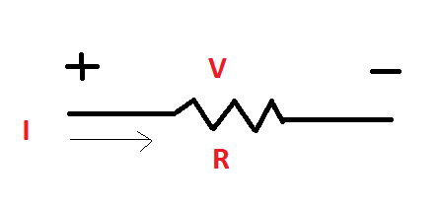
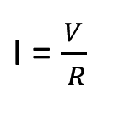
1.2 Resistor
Your first exploration into the world of electronics components will invariably include the humble resistor. This component is by far the simplest – a resistor impedes the flow of current. A resistor is a dissipative element that converts electrical energy into heat. Ohm’s law defines the voltage-current characteristic of an ideal resistor:
where V is the potential difference across resistor R and I is the current flow through the resistor R. The unit of resistor is ohm and we show it by the symbol Ω

Slide 15
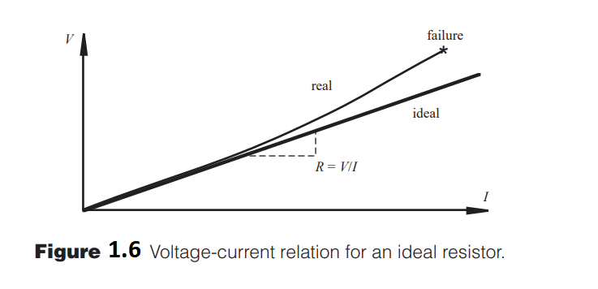
Resistance is a material property whose value is the slope of the resistor’s voltage-current curve. For an ideal resistor, the voltage-current relationship is linear, and the resistance is constant. However, real resistors are typically nonlinear due to temperature effects. As the current increases, temperature increases resulting in higher resistance. Also a real resistor has a limited power dissipation capability designated in watts (W), and it may fail when this limit is exceeded.

Slide 16
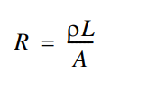
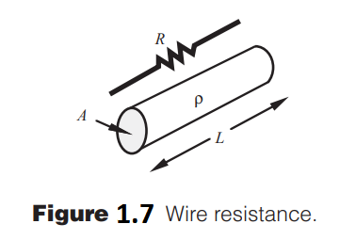
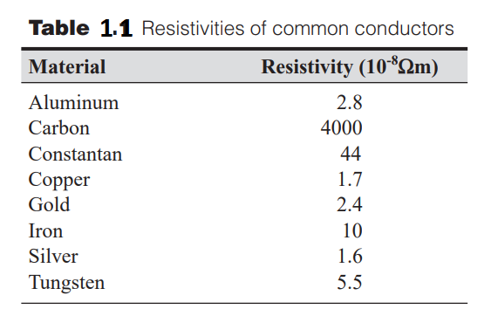
If a resistor’s material is homogeneous and has a constant cross-sectional area, such as the cylindrical wire illustrated in Figure 1.7 , then the resistance is given by;
where is the resistivity, or specific resistance of the material; L is the wire length; and A is the cross-sectional area.

Slide 17
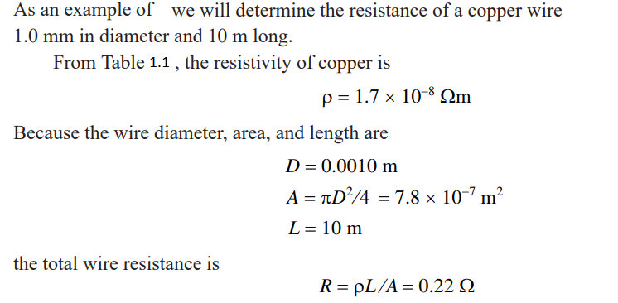
Example

Slide 18
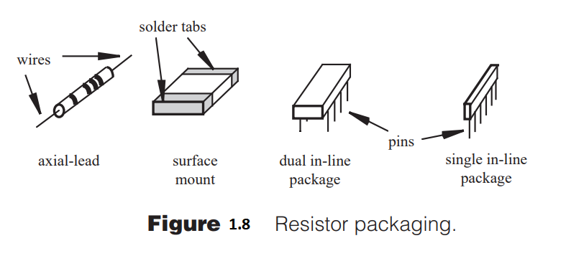

An axial-lead resistor’s value and tolerance are usually coded with four colored bands ( a, b, c, tol ) as illustrated in Figure 1.9 . The colors used for the bands are listed with their respective values in Table 1.2. A resistor’s value and tolerance are expressed as

Slide 19
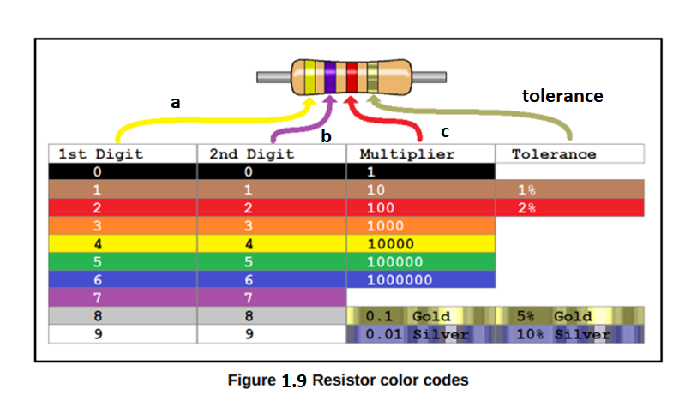
Here is a popular (and politically correct) mnemonic you can use to remember the resistor color codes when you don’t have a table handy: “Bob Brown Ran Over YellowW Grass, But Violet Got Wet.” The capitalized letters identify the colors.

Slide 20

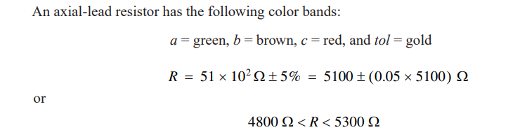
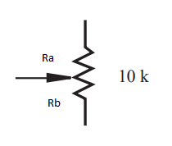
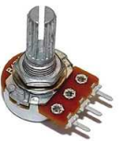

Variable resistors are available that provide a range of resistance values controlled by a mechanical screw, knob, or linear slide. The most common type is called a potentiometer, or pot. The direction to rotate the potentiometer for increasing resistance is usually indicated on the component.
Potentiometer Symbol

Slide 21
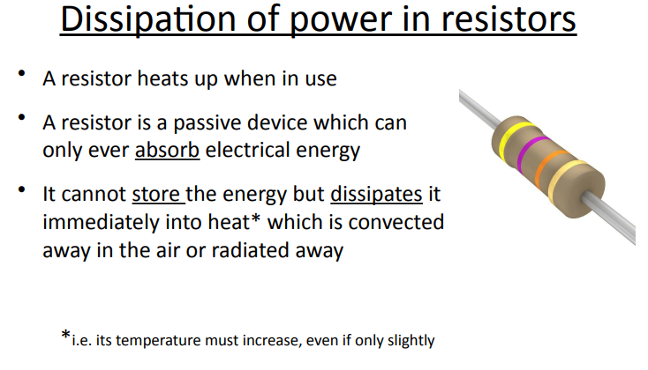

Slide 22
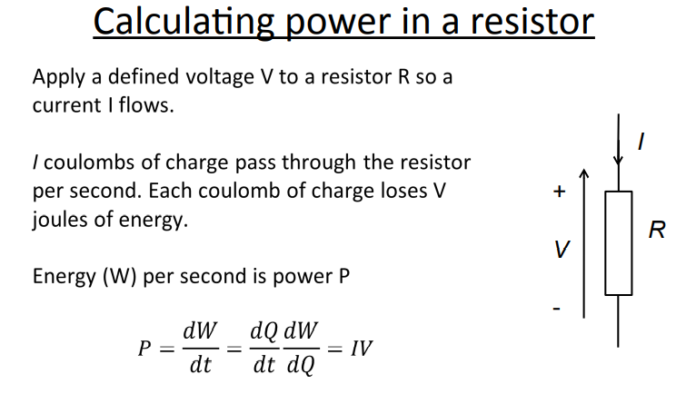

Slide 23
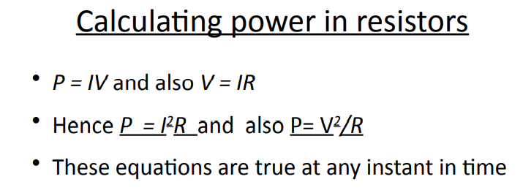

Slide 24
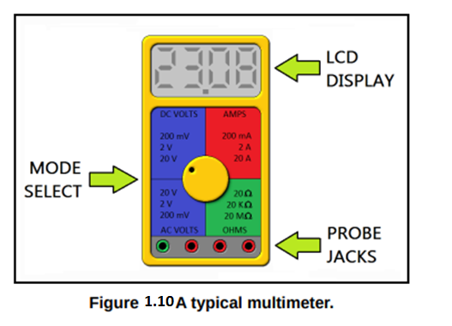
1.3 Measuring Voltage, Current, and Resistance
Of the many types of test equipment you will use in your electronics career, there are few instruments as versatile as the multimeter. In Figure 1.10 below, a typical multimeter is shown.
A multimeter is a meter that can measure voltage, current, resistance, and even test transistors and diodes. Having one on your bench is recommended, as they can be invaluable tools for continuity testing (for shorts or open circuits) and for determining unknown resistances.

Slide 25
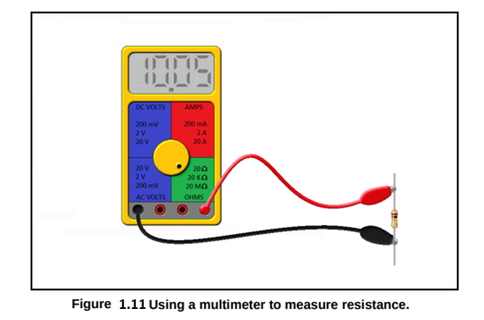
Using a Multimeter to Measure Resistance
To use the multimeter to measure resistance, place the resistor in the test clips as shown below in Figure 1.11. You may also measure transformer coils and motor coils to check for continuity in this way. You will find that even your skin has a measurable resistance! Don't worry, you won't feel anything! The multimeter uses an internal battery (usually +9V) to measure resistance.
It should be noted that it is unwise to measure resistors that are placed in a circuit, regardless of whether the circuit is under power or not. A multimeter will use an internal battery to inject a small current through the resistor under test to measure its resistance.
To get an accurate reading, and to ensure that no damage occurs to surrounding components or your meter, you should unsolder one leg of the resistor you would like to measure to remove it from the circuit temporarily.

Slide 26
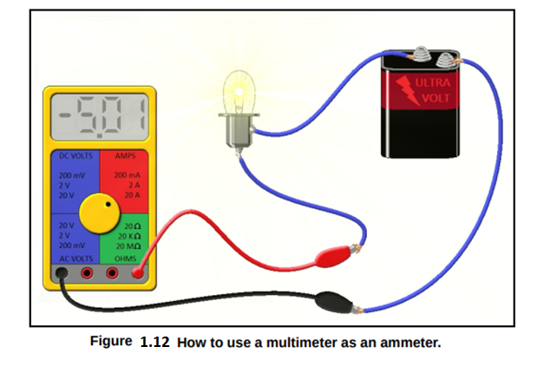
To measure current with a multimeter, we must place it in series with the circuit under test. In this configuration, the meter becomes a part of the circuit. In Figure 1.12, you will see the correct way to use a multimeter in the ammeter mode. Pay special attention to the jacks on the multimeter, as each multimeter varies. If you know you are measuring alternating current, use the AC ammeter setting. If you are measuring direct current, use the DC ammeter setting. You may notice that the current is negative in the diagram. Can you offer an explanation as to why that is? Hint: The outer terminal on a 6V battery like the one shown is positive.
Measuring Current with a Multimeter

Slide 27
There is usually more than one positive (red) jack for your test leads on the front panel of the multimeter. The jacks on a multimeter are fused for protecting the meter during current measurements. So make sure you are using the right jack for the circuit under test and for the current mode setting on your meter. Failure to do so may blow a fuse in the meter, or worse. For example, if you are in 10 Amp mode, use the jack marked “10 A.” And finally, be aware that if you place the test clips in the circuit backwards in DC ammeter mode, you will not hurt the meter. You will instead see a negative current indication.

Slide 28
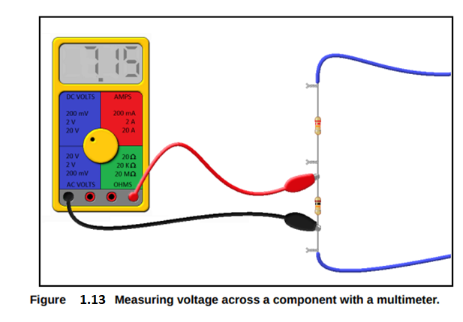
Measuring Voltage with a Multimeter
To measure voltage across a component with a voltmeter, you place it in parallel with the component under test. A voltmeter draws almost no current at all, so this measurement will not interfere in the operation of the circuit under test. Figure 1.13 shows a voltmeter being used to check a resistor in a circuit.
Make sure that you are measuring the voltage on the right setting. You won't hurt your meter if you are measuring an AC voltage with the meter set to DC mode, but you may not read the voltage you expect.

Slide 29
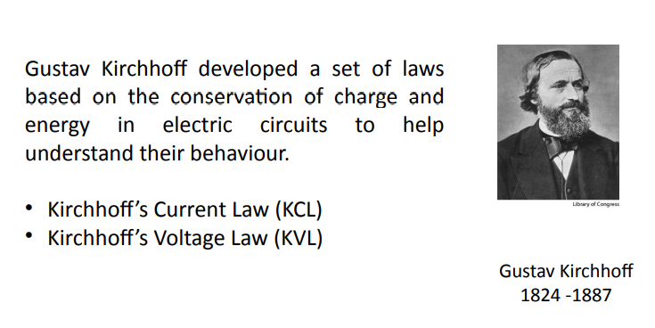
1.4 KIRCHHOFF’S LAWS

Slide 30

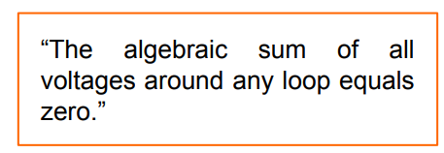
Now we are ready to put circuit elements and sources together in circuits and calculate voltages and currents anywhere in the circuit. Kirchhoff’s laws are essential for the analysis and understanding of circuits, regardless of how simple or complex the circuit may be. In fact, these laws are the basis for even the most complex circuit analysis such as that involved with transistor circuits, operational amplifiers, or integrated circuits with hundreds of elements.
Kirchhoff’s voltage law (KVL) states that the sum of voltages around a closed loop or path is 0 .
Note that the loop must be closed, but the conductors themselves need not be closed (i.e., the loops can go through open circuits).

Slide 31
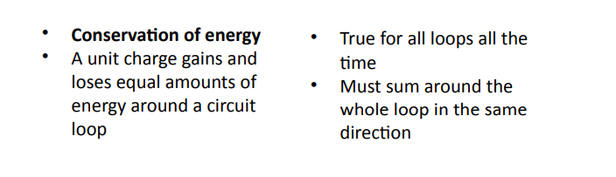
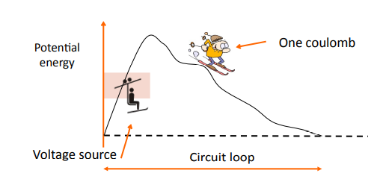

Slide 32
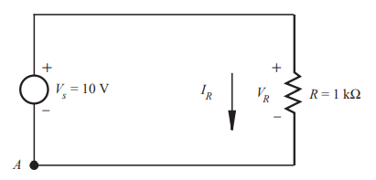
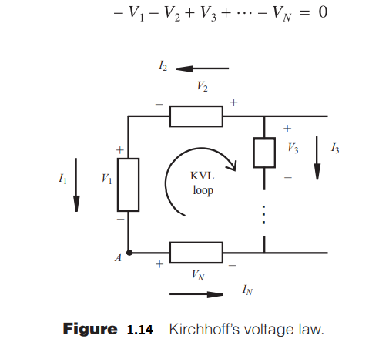



KVL will be used to find the current in the following circuit.
Applying Ohm’s law,

Slide 33
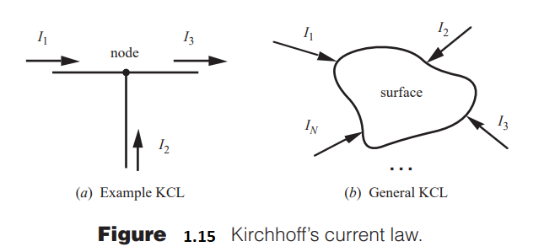
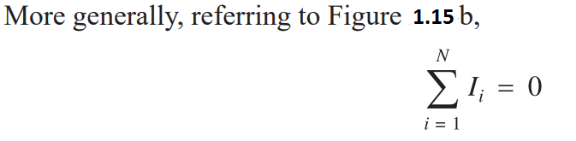
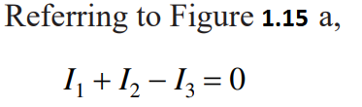
Kirchhoff’s current law (KCL) states that the sum of the currents flowing into a closed surface or node is 0.
Note that currents entering a node or surface are assigned a positive value, and currents leaving are assigned a negative.

Slide 34
Some important remarks.
It is important to note that, when analyzing a circuit, you arbitrarily assume current directions and denote the directions with arrows on the schematic.
If the calculated result for a current is negative, the current actually flows in the opposite direction. Also, assumed voltage drops must be consistent with the assumed current directions.
If a calculated voltage is negative, its actual polarity is opposite to that shown.
2A +I = 3A + 5 A
2A + I = 8 A
I = 6 A
5A
2A
I
3A

Slide 35
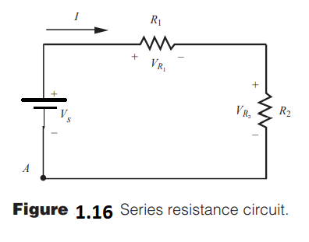



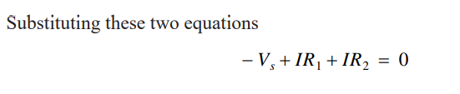

1.5 Series Resistance Circuit
Applying KVL to the simple series resistor circuit illustrated in Figure 1.16 yields some useful results. Assuming a current direction I, starting at node A, and following a clockwise direction yields
From Ohm’s law
and
Solving for I yields

Slide 36


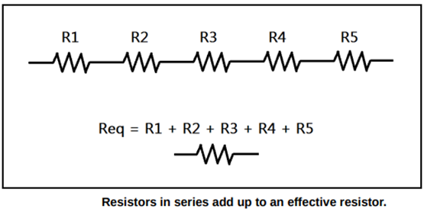
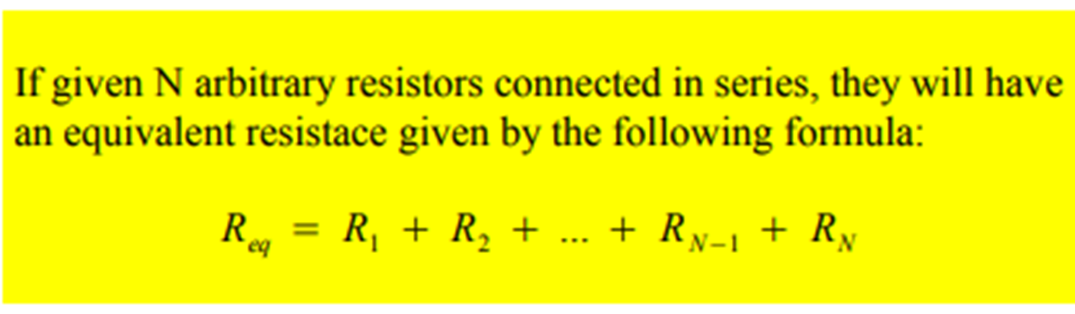
Note that, if we had a single resistor of value R1 + R2 , we would have the same result. Therefore resistors in series add, and the equivalent resistance of a series resistance circuit is
In general, N resistors connected in series can be replaced by a single equivalent resistance given by

Slide 37
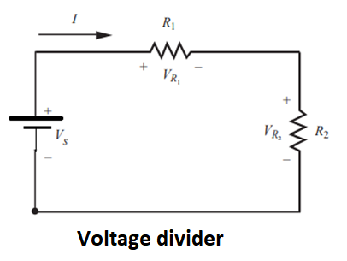
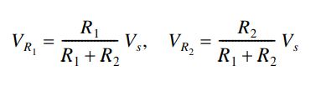
A circuit containing two resistors in series is referred to as a voltage divider because the source voltage Vs divides between each resistor.

Slide 38
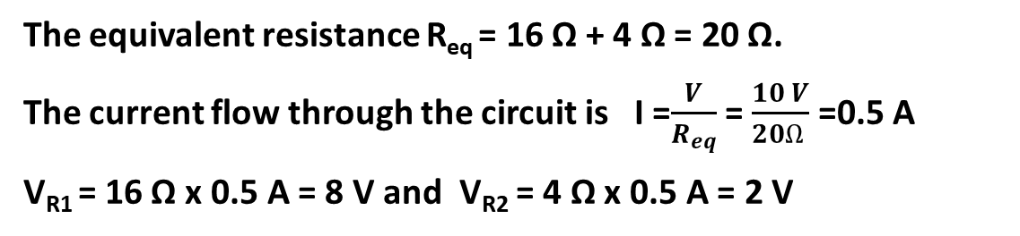
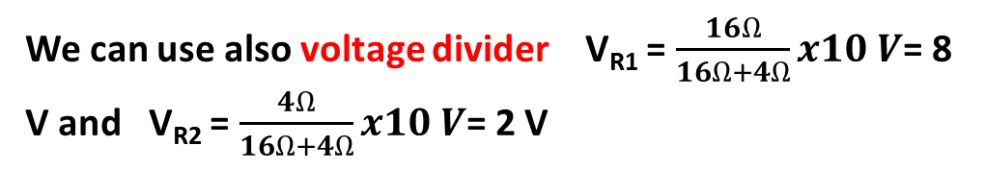
Example
Find the current flow through the circuit and voltage drop across each resistor.
Solution
The equivalent resistance R_{eq} = 16 Ω + 4 Ω = 20 Ω.
The current flow through the circuit is I =$\frac{V}{R_{eq}}$ = $\frac{10 V}{20Ω }$ =0.5 A
V_{R1} = 16 Ω x 0.5 A = 8 V and V_{R2} = 4 Ω x 0.5 A = 2 V
We can use also voltage divider V_{R1} = $\frac{16Ω}{16Ω+4Ω}x10 V$= 8 V and V_{R2} = $\frac{4Ω}{16Ω+4Ω}x10 V$= 2 V

Slide 39
Example
Find the current flow through the circuit and voltage drop across each resistor by applying KVL. Calculate the power dissipation of each resistor.
Solution
Let I be the loop current. By applying KVL around the loop in the clockwise direction;
- 10 V + (7 Ω x I) + 6 V + ( 3 Ω xI ) -10 V = 0
10 Ω x I = 14 V Then I = 1.4 A
VR1 = 7 Ω x 1.4 A = 9.8 V Power dissipation of R1; P1 = I x VR1 = 1.4 A x 9.8 V =13.72 W
VR2 = 3 Ω x 1.4 A = 4.2 V Power dissipation of R2; P2 = I x VR2 = 1.4 A x 4.2 V = 5.88 W

Slide 40
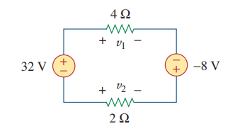



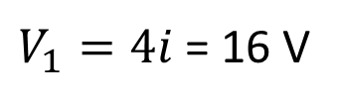
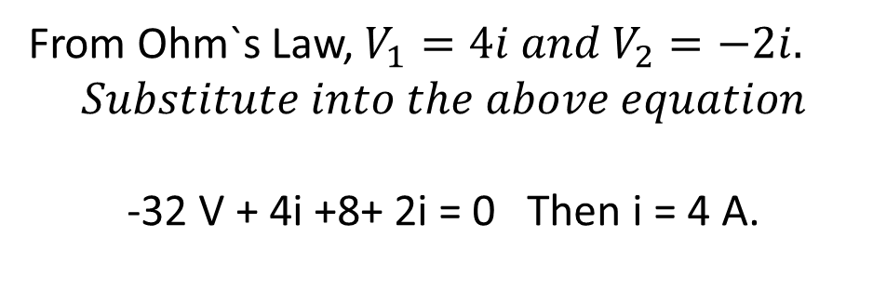

Example
Solution
We apply KVL around the loop in the clockwise direction.
$−32V+V_{1}−\left(−8V\right)−V_{2}$= 0
From Ohm`s Law, $V_{1}=4i and V_{2}=−2i.$
$$Substitute into the above equation$$
-32 V + 4i +8+ 2i = 0 Then i = 4 A.
$V_{1}=4i$= 16 V
$$V_{2}=−2i=−8V$$

Slide 41










1.6 Series Resistors and Voltage Division

Slide 42




This is called the principle of voltage division,

Slide 43



1.7 Parallel Resistors and Current Division
Consider the circuit below, where two resistors are connected in parallel and therefore have the same voltage across them.

Slide 44




We can extend the result in parallel of two resistance to the general case of a circuit with N resistors in parallel. The equivalent resistance is
Given the total current i entering node a in figure below, how do we obtain current i₁ and i₂?

Slide 45




Example
Find R_{eq} for the circuit shown below
Solution

Slide 46





Slide 47







Example
Find i_{o} and V_{o} in the circuit shown below. Calculate the power dissipated in the 3 Ω resistor
Solution

Slide 48





Slide 49

1.8 Capacitor
A capacitor is a passive element that stores energy in the form of an electric field. This field is the result of a separation of electric charge. The simplest capacitor consists of a pair of parallel conducting plates separated by a dielectric material as illustrated in Figure 1.18

Slide 50


The dielectric material is an insulator that increases the capacitance as a result of permanent or induced electric dipoles in the material.
Strictly, direct current (DC) does not flow through a capacitor; rather, charges are displaced from one side of the capacitor through the conducting circuit to the other side, establishing the electric field. The displacement of charge is called a displacement current because current appears to flow through the device as it charges or discharges. The capacitor’s voltage-current relationship is defined as
where q ( t ) is the amount of accumulated charge measured in coulombs and C is the capacitance measured in farads and by differentiating this equation, we can relate the displacement current to the rate of change of voltage

Slide 51

Capacitance is a property of the dielectric material and the plate geometry and separation. Values for typical capacitors range from 1 pF to 1000 uF, but they are also available with much larger values.
The primary types of commercial capacitors are electrolytic capacitors, tantalum capacitors, ceramic disk capacitors, and mylar capacitors.
Electrolytic capacitors are polarized, meaning they have a positive end and a negative end. The positive lead of a polarized capacitor must be held at a higher voltage than the negative side; otherwise, the device will usually be damaged

Slide 52


Example
Find the equivalent capacitance for the following circuit
$$\frac{1}{C_{eq}}=\frac{1}{2uF}+\frac{1}{4uF}+\frac{1}{6uF}$$
$$\frac{1}{C_{eq}}= \frac{44}{48uF}$$
$$C_{eq}=1.09 uF$$

Slide 53


Example
Find the equivalent capacitance for the following circuit
$$C_{eq}=2uF+4uF+6uF=12uF$$

Slide 54

When we charge or discharge capacitors, they do not charge or discharge instantly. They take a certain amount of time to charge or discharge completely. The amount of time to charge a capacitor depends on the capacitance and the resistance in the circuit. Take a look at Figure 1.20, shown below.

Slide 55

When we depress and hold the push-button switch SW1, the capacitor begins charging (the schematic
at left.) Instantaneously, the capacitor begins to flood with charges, and looks like a dead short. The
only thing limiting current at this point is the resistor. As the charge begins to build up in the capacitor,
the current decreases. Finally, after a certain amount of time, the current stops altogether and the
capacitor is fully charged. The amount of time it takes to do this depends on the time constant of the
capacitor and resistor, called the RC time constant, which we will now define.
The RC time (τ) is the time that it takes for the voltage of the capacitor to reach 63% of the highest voltage at the input V_{o}.

Slide 56

The Greek letter τ (lowercase tau) is used to represent the time constant R * C, and is measured in seconds. After the switch SW1 in Figure 1.20 is pressed and held, the capacitor is said to be fully charged after about 5τ, or “five tau.” If we release switch SW1 at this point, the capacitor will retain the charge until a discharge path is created. We will now give the capacitor charging function for the voltage across a capacitor with respect to time.
From the above expression when τ = RC, V(τ ) = 0.63 V₀. For example if V_{o} = 5 V and τ = 1 msec then
at V(τ ) = 0.63 x 5V = 3.15 V .

Slide 57

When we discharge a capacitor, it begins to dump its stored charge into the discharge path, acting as a temporary voltage source. In Figure 1.20, look at the schematic on the right. If we depress and hold switch SW2, the charge stored in the capacitor is given a discharge path through the resistor. Once again, it takes about 5τ to discharge the capacitor to 0 V. We now give the capacitor discharging function for voltage across a capacitor with respect to time
Similarly, discharging time τ is the time when the discharging voltage decreases 36% from its highest voltage V_{o}.
From the above expression when τ = RC, V(τ ) = 0.36 V₀. For example if V_{o} = 5 V and τ = 1 msec then
at V(τ ) = 0.36 x 5V = 1.8 V .

Slide 58

What do you suppose happens to the energy when the capacitor discharges? It is dissipated as heat by the resistor in the discharge path. Therefore, both energy and charge are conserved. Capacitors are said to resist changes in voltage. This is due to their being able to store charges when the applied voltage increases, and to deliver those stored charges when the applied voltage decreases. This is what makes them useful for filtering. They also block DC, since no current flows when fully charged

Slide 59

Example
a) When switch S2 is open and switch S1 is closed find the voltage across the capacitor C1 after 3 sec.
When SW S2 is open and S1 is closed capacitor is charging through the resistance R1. Charging time constant is $τ$ = 10kΩ x 100 uF = 1 sec.
V_{C}(t) = 10 ( 1 - $e^{−\frac{t}{1sec}}$)
V_{C}(3sec) = 10 ( 1 - $e^{−\frac{3 sec}{1sec}}$) = 9.5 V

Slide 60

b) When switch S1 is open and switch S2 is closed find the voltage across the capacitor C after 3 sec.
When SW S1 is opened and S2 is closeded capacitor is discharging through the resistance R2. Discharging time constant is $τ$ = 20kΩ x 100 uF = 2 sec.
V_{C}(t) = 9.5 $e^{−\frac{t}{2sec}}$
V_{C}(3sec) = 9.5 $e^{−\frac{3 sec}{2sec}}$ = 2.12 V

Slide 61

We just described the functions for charging and discharging capacitors with a series resistance. Let's look at Figure 1.21, shown above. We can clearly see the exponential nature of charge and discharge curves in this graph. After a time of 1τ, a charging capacitor is charged to about 63% of the applied voltage, while a discharging capacitor is discharged to about 36% of its initial voltage. We may use these facts to measure an unknown capacitance if the series resistance is known.
1.9 Inductor
An inductor is a passive energy storage element that stores energy in the form of a magnetic field. The simplest form of an inductor is a wire coil, which has a tendency to maintain a magnetic field once established. The inductor’s characteristics are a direct result of Faraday’s law of induction, which states
where is the total magnetic flux through the coil windings due to the current. Magnetic flux is measured in webers (Wb)

Slide 62



The magnetic field lines surrounding an inductor are illustrated in Figure 1.22
The south-to-north direction of the magnetic field lines, shown with arrowheads
in the figure, is found using the right-hand rule for a coil.
For an ideal coil, the flux is proportional to the current:
where L is the inductance of the coil, which is assumed to be constant. The unit of
measure of inductance is the henry (H = Wb/A).
An inductor’s voltage-current relationship can be expressed as
If the current through the inductor is
increasing (d I /d t > 0), the voltage polarity is as shown in Figure 1.22 . If the current through the inductor is decreasing (d I /d t < 0), the voltage polarity is opposite to that shown.

Slide 63

In Figure 1.23, we have some examples of the inductors you will come across. A transformer is also shown, because it is also a device that uses electromagnetism. Transformers “transform” one voltage to another, and to provide isolation. Transformers are just one example of the many types and styles of inductors you might come across. Let's look at a few of them

Slide 64



Problems
1. For each of the circuit below apply KVL to find the unknown voltages.
(b)
(a)
(c)

Slide 65



2. For each of the circuit below apply KCL to find the unknown currents.
(a)
(b)
(c)

Slide 66



3. Calculate the unknowns for each of the circuit below.
(a)
(b)
(c)

Slide 67





4.
Calculate R _{ab} the equivalent resistance at terminals a-b for each of the circuits

Slide 68


5. Calculate the unknowns for each of the circuit below.

Slide 69



(g)
(h)

Slide 70
6. Find the current through each circuit
b
a
c
d

